Slide 1
Lighting Design

Slide 2
What is the Differences between old and new Lighting system?
Why we need
smart home Lighting system?

Slide 3
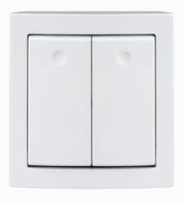
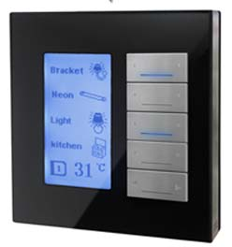
1
Many switches
Ugly and hard to use
1 Panel
User Friendly

Slide 4
Digital experience, control, simple
Easy for all users with graphic multi language

Slide 5
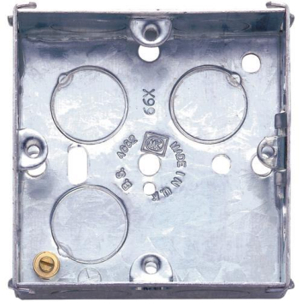
2
More conduits
More back boxes
Less conduits
1 back box

Slide 6
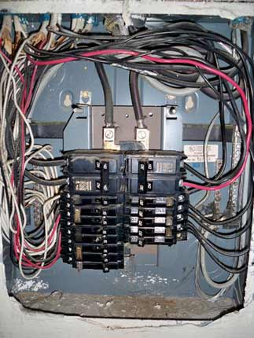
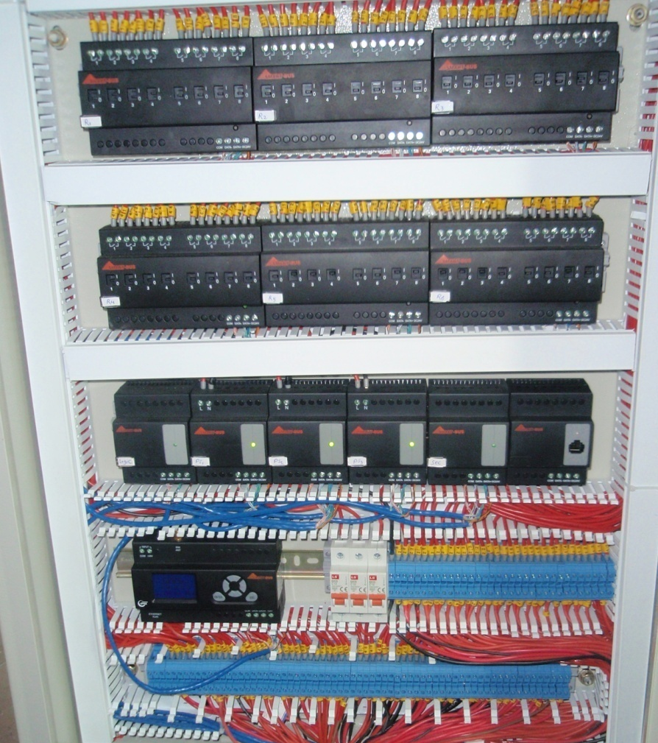
3
Not stable wiring
Not organized
Life time wiring
Organized and labeled

Slide 7
4
Saving Energy
More control
1 network
Flexibility

Slide 8
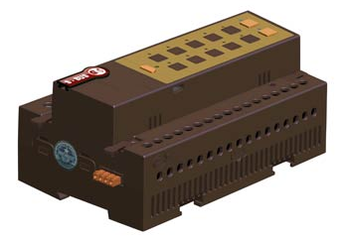
How we control the lights? By ON/OFF By Dimming

Slide 9
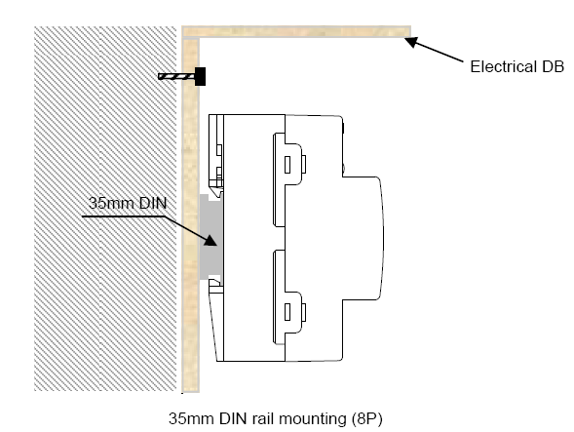
Expression
What is Din rail

Slide 10
What is lighting Channel?
How to calculate Amp?

Slide 11
What is lighting Channel?
The channel is set of lights turning On/OFF together
How to calculate Amp?
Amp= Watt/Volt
If a lamp of 50 watt than
50/220volt= 0.2 A

Slide 12
ON/OFF Relay 4 Ch 20 A Relay 4 Ch 16 A Relay 6 Ch 16 A Relay 8 Ch 16 A Relay 12 Ch 10A Relay 3 Ch 01A
Dimming
Dimmer 2 Ch 6 A Dimmer 4 Ch 3 A
Dimmer 6 Ch 2 A

Slide 13
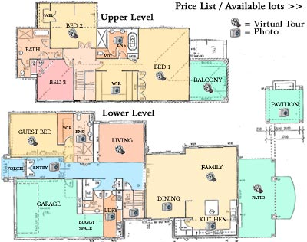
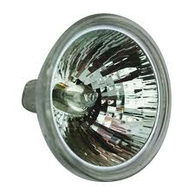
Where to use Dimmer ? Where to use Relay?

Slide 14
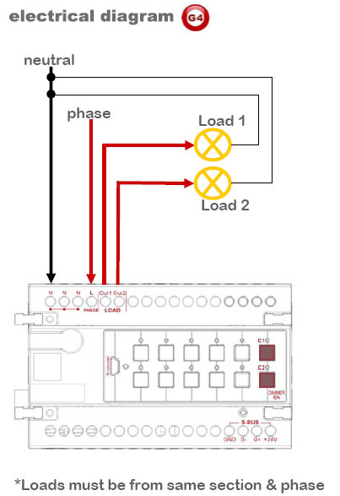

Slide 15
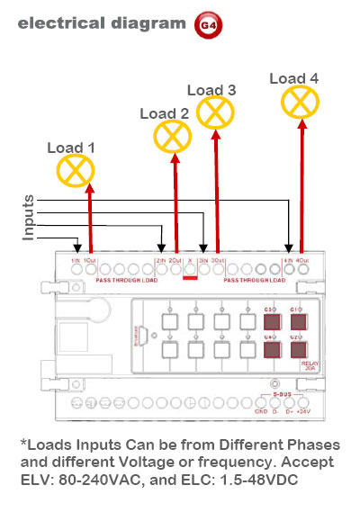

Slide 16
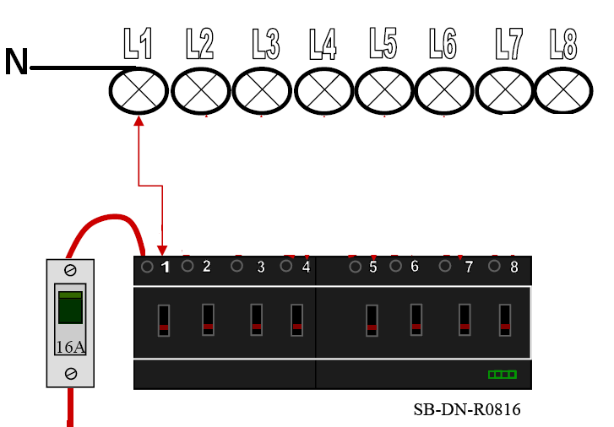
Smart-Bus Lighting controller
Relay connection

Slide 17
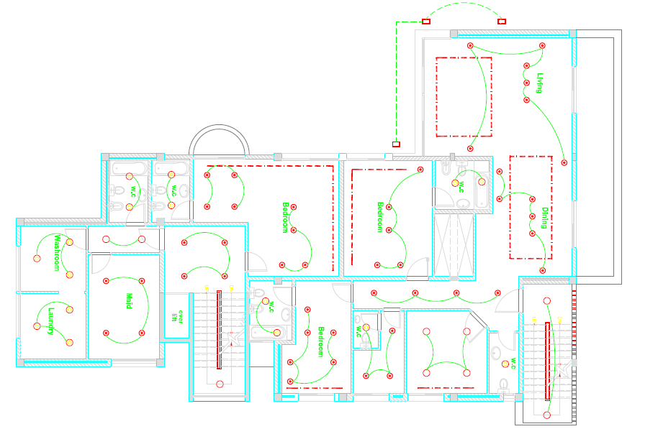
Floor Lighting Example
Each spot of 50 Watt

Slide 18
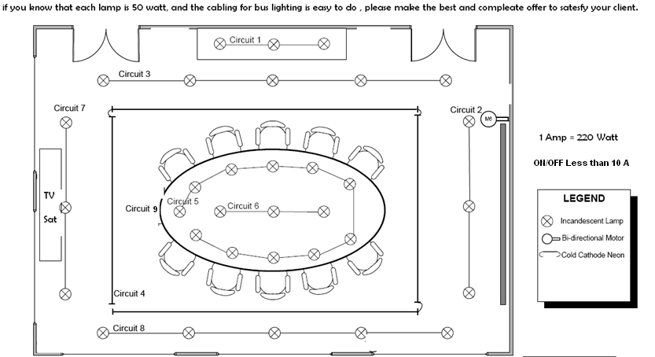
Exercise

